Slide 1

Software Quality Engineering
BSSE-VI
Dr. Sumaira Nazir
Assistant Professor
Department of Software Engineering
National University of Modern Languages, Islamabad

Slide 2
GQM

Slide 3
Product Standards-Goal-Question-Metric Model Structure
GQM, the acronym for "goal, question, metric", is an approach to software metrics that has been promoted by Victor Basili

Slide 4
Product Standards-Goal-Question-Metric Model
GQM defines a measurement model on three levels:
Conceptual level (Goal)
A goal is defined for an object, for a variety of reasons, with respect to various models of quality, from various points of view and relative to a particular environment.
Operational level (Question)
A set of questions is used to define models of the object of study and then focuses on that object to characterize the assessment or achievement of a specific goal.
Quantitative level (Metric)
A set of metrics, based on the models, is associated with every question in order to answer it in a measurable way.

Slide 5
Product Standards-Goal-Question-Metric Model
Set goals specific to needs in terms of purpose, perspective and environment.
Refine the goals into quantifiable questions that are tractable.
Deduce the metrics and data to be collected (and the means for collecting them) to answer the questions

Slide 6
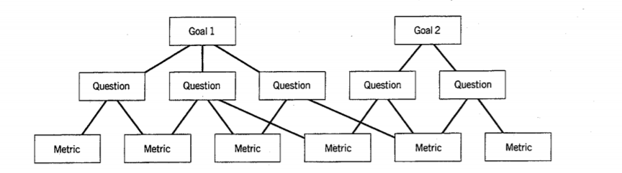
Product Standards-Goal-Question-Metric Model Structure

Slide 7
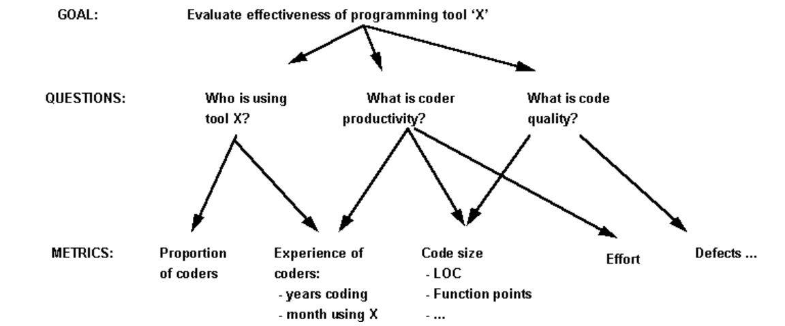
Product Standards-Goal-Question-Metric Model Example

